Slide 1
www.MINEPORTAL.in
ONLINE TEST SERIES FOR
DGMS COAL/METAL FIRST/SECOND CLASS EXAM
GATE MINING EXAM
OVERMAN EXAM TEST
MINING INSPECTOR EXAMS
COAL INDIA MTs & OTHER PSUs EXAMS
FREE STUDY MATERIAL & VIDEO LECTURES
MINING JOBS NOTIFICATIONS
www.mineportal.in Call/Whatsapp-8804777500 www.fb.com/mineportal.in

Slide 2
Safety devices in belt conveyor

Slide 3
Safety devices are useful to long life of belt conveyor and to prevent hazards.
Different parts of belt conveyor are attached with safety devices.
Generally these safety devices work when problems arrive in that particular part of the belt conveyor.

Slide 4
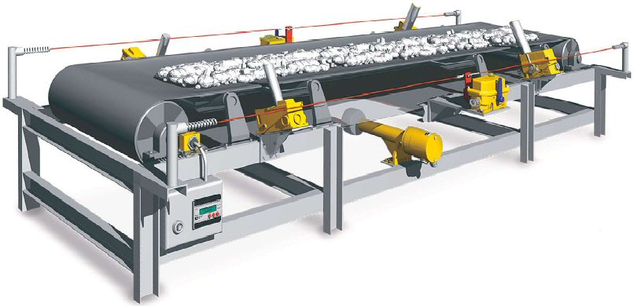

Slide 5
safety devices
To prevent running down the belt due to gravity when power is cut off in ascending belt conveyor ratchet and pawl mechanism is used. They allow the belt to move up but not down.
To prevent heat related hazards cooling devices are used to reduce the hot surface temperature.

Slide 6
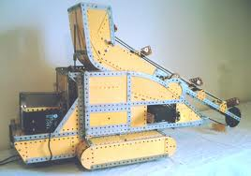
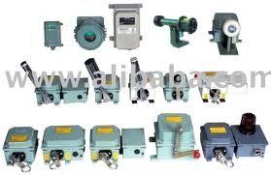

Slide 7
Devices, appliances, fasteners and other equipments are used in electrical power supply to prevent electrical hazards.
Devices are attached in belt conveyor to prevent fire and explosion hazard.
A provision of emergency stop is also provided in belt conveyor system.

Slide 8
TH
KS
AN

